Slide 1
OLYMPICS DATA ANALYSIS
Project-2
By
Sravani Chekurtha
Shetu das
Ankit Sharma
Ch Nishank
Submitted to
Ajay Singala

Slide 2

OLYMPIC DATA ANALYSIS
By

Slide 3

OLYMPIC DATA ANALYSIS
Project-2
By

Slide 4
Olympic Dataset
No of Dataset : 2
Dataset Type : CSV
Name of Dataset: athlete_events and noc_regions
No of Column in athlete_events dataset : 12
No of Column in noc_regions dataset : 3
Github URL : https://github.com/chnishank/Project2
Dataset Download URL : https://www.kaggle.com/heesoo37/120-years-of-olympic-history-athletes-and-results

Slide 5
Datasets Schema
athlete_events
|-- ID: integer (nullable = true) |-- Name: string (nullable = true) |-- Sex: string (nullable = true) |-- Age: integer (nullable = true) |-- Height: integer (nullable = true) |-- Weight: integer (nullable = true) |-- Team: string (nullable = true) |-- NOC: string (nullable = true) |-- Games: string (nullable = true) |-- Year: integer (nullable = true) |-- Season: string (nullable = true) |-- City: string (nullable = true) |-- Sport: string (nullable = true) |-- Event: string (nullable = true) |-- Medal: string (nullable = true)
noc_regions
|-- NOC: string (nullable = true) |-- Region : string (nullable = true) |-- Notes: string (nullable = true)

Slide 6
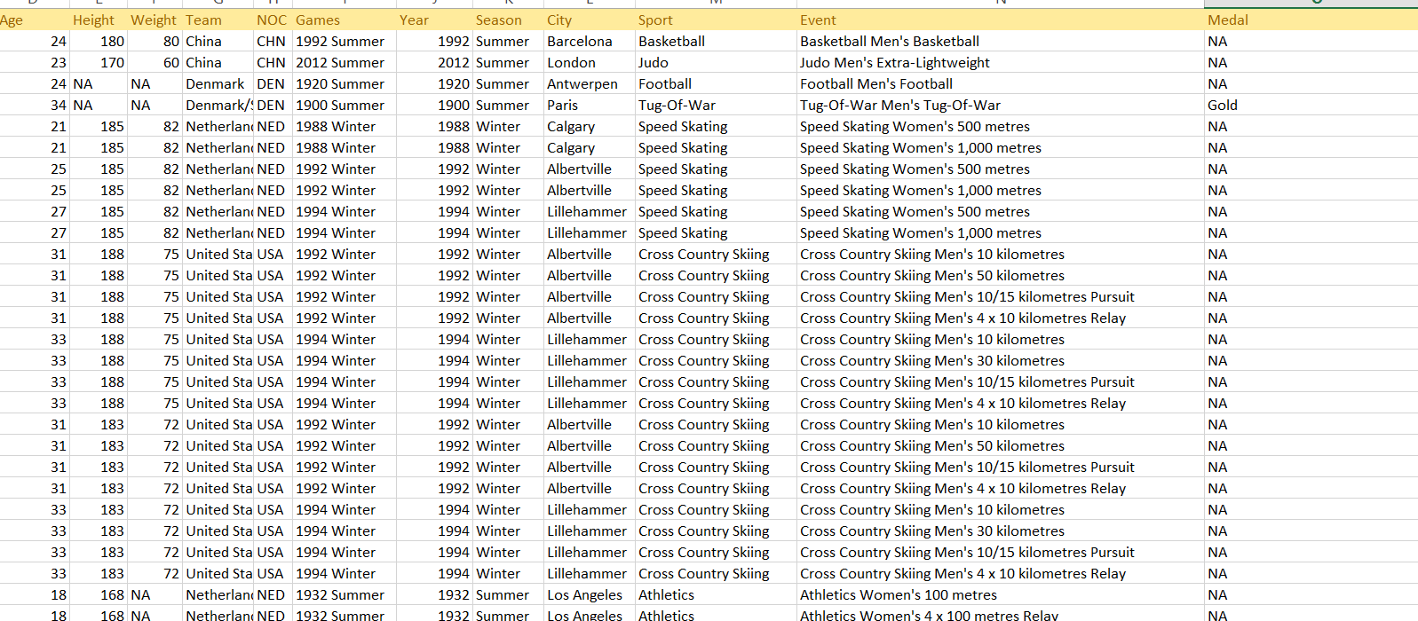
athlete_events csv file

Slide 7
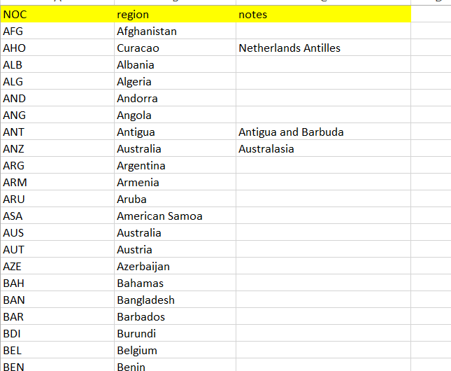
noc_regions csv file

Slide 8
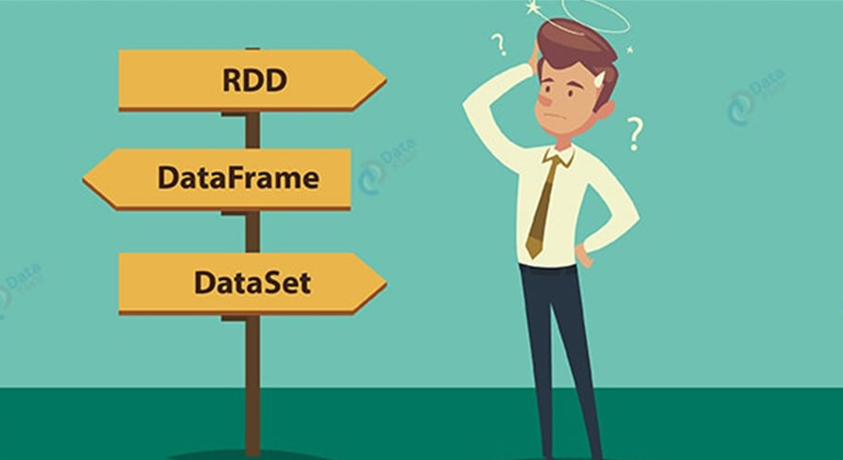
Technology Used
Spark Data Frame
Spark SQL

Slide 9
Why Spark dataFrame?
1.DataFrame is distributed collection of data. In DataFrames, data is organized in named column.
2. They are conceptually similar to a table in a relational database. Also, have richer optimizations.
3. DataFrames empower SQL queries and the DataFrame API.
4. we can process both structured and unstructured data formats through it. Such as: Avro, CSV, elastic search, and Cassandra. Also, it deals with storage systems HDFS, HIVE tables, MySQL, etc.
5. The DataFrame API’s are available in various programming languages. For example Java, Scala, Python, and R.
6. DataFrame provides easy integration with Big data tools and framework via Spark core.

Slide 10
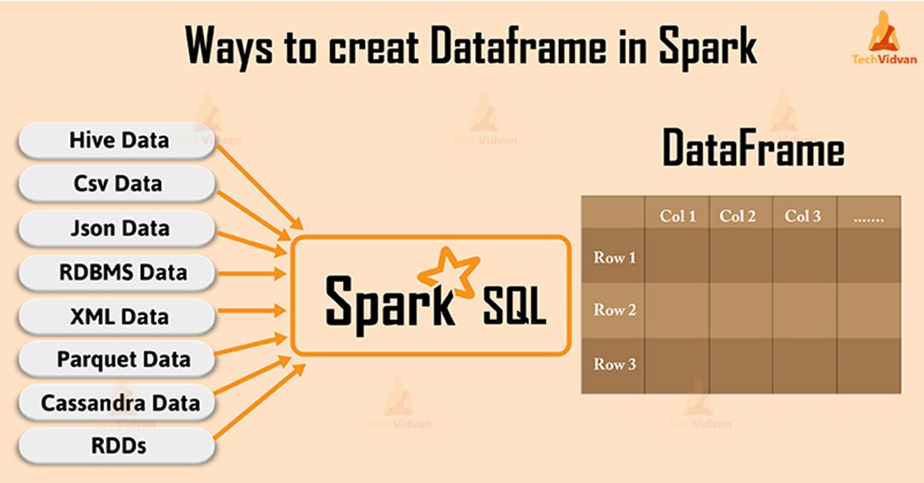

Slide 11
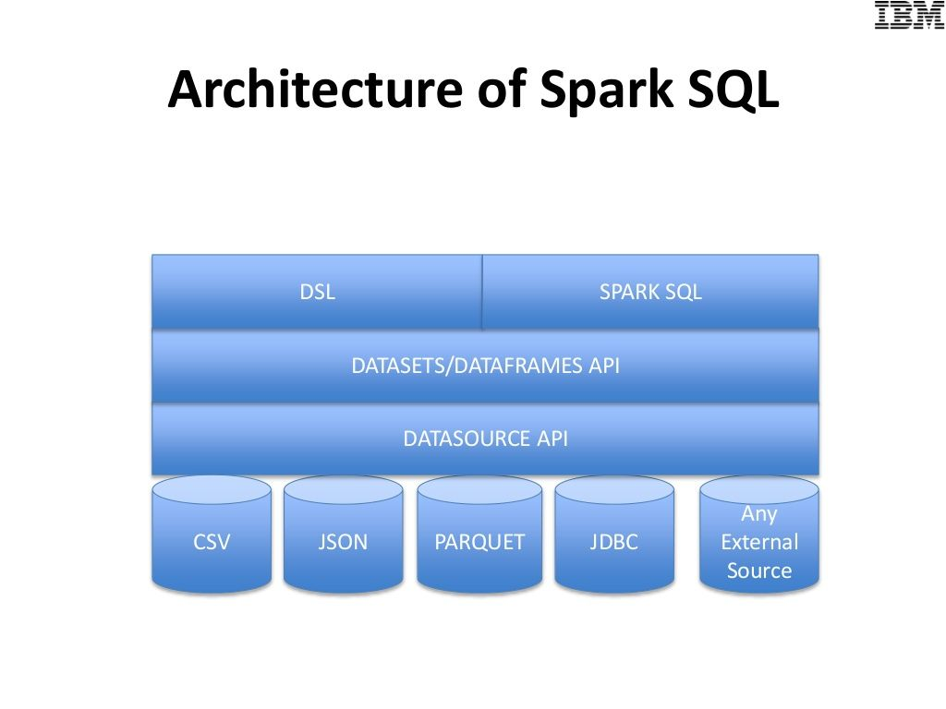

Slide 12
DataFrame Schema
schema = StructType() \
.add("ID",IntegerType(),True) \
.add("Name",StringType(),True) \
.add("Sex",StringType(),True) \
.add("Age",IntegerType(),True) \
.add("Height",IntegerType(),True) \
.add("Weight",IntegerType(),True)\
.add("Team",StringType(),True) \
.add("NOC",StringType(),True) \
.add("Games",StringType(),True) \
.add("Year",IntegerType(),True) \
.add("Season",StringType(),True) \
.add("City",StringType(),True) \
.add("Sport",StringType(),True) \
.add("Event",StringType(),True) \
.add("Medal",StringType(),True)

Slide 13
About Project Analysis
1) Write a Query to Count Female participants in year 2004 from India? 2)Write a Query to fetch top 10 youngest athletes to ever compete in the Games? 3) Write a Query to display the year when women get started to enter into Olympics ? 4) Write a Query to Count the number of male and female participants in each sport from 1896 to 2006? 5) Write a Query to Count the no of Females Participants from each country in every year 6)Write a Query to fetch how many Indian took participated in every year? 7) write a Query to display distinct Sports in Olympics 8)Write a Query to count the no of females that have participated in Olympics 9) Write a Query to count how many gold medals Indian won in till now 10) Write a Query to count the number of participants in each sport 11) Write a Query to display the details of Indian players , who won gold , silver, bronze

Slide 14
c
12) write a Query to display all years in which Olympics held.
13) write a Query to display all the Countries participated in Olympics from 1896-2006.
14) Write a Query to find in which year India got most medals.
15) Write a Query to find Total_Medals , Gold Medals , Silver Medals and Bronze of Top 100 Olympians with their country Name and sport Name.
16) Write a Query to find Total_Medals , Gold Medals , Silver Medals , Bronze Medals of every country in the year 1912 with their rank.
17) write a query to display distinct player their country from India
18) Write a Query to display max weight of all time in Olympics
19) Write a Query to display which country received most medals in 2004
20) Write a Query to display in which sport, Indian won most medals from 1896-2006
21) Write a Query to display count of male and female in each year, for each country

Slide 15
Now We are going to Execute queries

